Slide 1
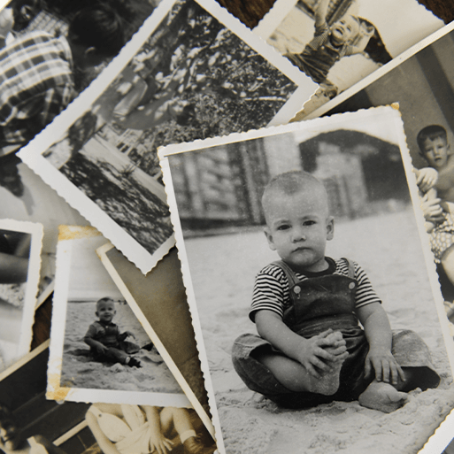
Childhood
Unicorn Class
Autumn Term 1 September 2024
TOPIC OVERVIEW
As Historians, we will learn about how life changes over time including our lives and important events in our lives. We will compare our lives today and children’s childhood in the 1950s.
As Scientists, we will explore objects which are made from different materials and identify the everyday material sources. We will investigate the properties of materials and begin to recognise that properties define its use. We will explore that humans are a type of animal known as a mammal, name and count body parts and identify similarities and differences. We will learn about our senses, the body parts associated with each sense and their role in keeping us safe.
As Design Technologists, we will learn about the purpose of shelters and their materials. We will name and describe shelters and design and make shelter prototypes.
As Geographers, we will learn about physical and human features, maps, cardinal compass points, and positional and directional language. We will learn about the equator, hemispheres and continents and be introduced to the countries, capital cities and settlements of the United Kingdom.
ENGLISH
Recounts, labels and captions: we will think about how important these things are for sharing information
Autobiographies: we will think about significant events in our life in chronological order, as well as the use of past tense.
Poetry: we will explore vocabulary to describe different historical artefacts and then use this to create riddle.
Non-Chronological Reports: we will find out what it was like to be a child in the 1950s.
How you can help at home:
Ensure homework is completed
Read regularly at home together
Support your child to learn their spellings
Encourage writing experiences where possible
MATHEMATICS
Children will be taught key aspects of the following:
Place Value
Addition
Subtraction
How you can help at home:
Ensure your child completes Numbots and/or Times Tables Rock Stars every week
Ensure homework is completed
Support your child to learn their number bonds to 10
RE
PSHE
Who do different Christians believe God is?
We will explore the different names and attributes of God. We will be introduced to Trinity and revisit the word ‘creator.’
Physical health and well-being
We will think about how we can eat well, the importance of physical activity, sleep and rest, as well as basic health and hygiene routines.
We will consider people who help us to stay healthy and well.
E-SAFETY & COMPUTING
MUSIC
In Computing we will be exploring the word ‘data’ and how data can be collected to create tally charts, pictograms and block graphs on a range of software.
Keeping the Pulse
We will explore the musical terms; pulse and rhythm through a variety of activities including; clapping our names, clapping in time with music, playing in time with music and copy and repeat rhythms.
Multi-skills
We will be developing our agility and coordination through a variety of games.
Athletics
We will practise throwing, jumping and developing our speed for running.
.
ART
PE
FRENCH
SMSC
We will use our Childhood theme for the basis of our art this term. We will create paperchain families and create spinning tops. We will explore the artists Romero Britto and Gustav Klimt and create artwork inspired by them.
Greetings and Songs
We will begin the year by thinking about how we greet people in different ways. This will lead onto how we can greet people in French.
As part of our SMSC curriculum, children will participate in a variety of activities including; Fairtrade Fortnight, Black History Month and World Mental Health Day.

