Slide 1
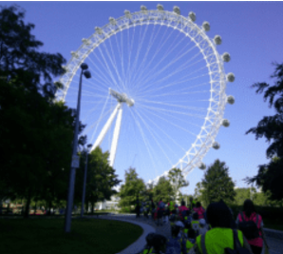
Capital Chaos
Unicorn Class
Spring Term 1
January 2025
TOPIC OVERVIEW
As Geographers, we will learn about the physical and human characteristics of the United Kingdom, including a detailed exploration of the characteristics and features of the capital city, London.
As Historians, we will learn about The Great Fire of London and the chronology of events that led up to it.
As Design Technologists, we will have a go at making models of London landmarks, including the London Eye.
As Scientists, we will think about the seasons, seasonal changes and typical seasonal weather and events. We will learn about measuring the weather and the role of a meteorologist.
ENGLISH
Children will be taught the following genres:
Stories with predictable patterns
Recount
Directions
Poems on a theme
How you can help at home:
Ensure homework is completed
Read regularly at home together
Support your child to learn their spellings
Encourage writing experiences where possible
MATHEMATICS
Children will be taught key aspects of the following:
Year 1:
Shape
Place Value within 10
Addition & Subtraction within 20
Year 2:
Subtraction
Shape
Money
How you can help at home:
Ensure your child completes their CGP books every week
Support your child to learn their number bonds to 10/100
Practice counting in 2s, 5s and 10s
Explore the app ‘One Minute Maths.’
RE
Mental Health and Emotional
Wellbeing: Friendships
We will think about the importance of special people in our lives. We will learn about who can help us with friendships and about making friends. We will think about how we can solve problems that might arise with friendships.
PSHE
How do Christians know what is right?
We will explore where Christians seek guidance, how they make decisions and evaluate their decisions.
E-SAFETY & COMPUTING
MUSIC
In Computing we will be designing and programming the movement of a character on a screen to tell stories.
On this Island
We will learn folk songs and create sounds to represent three contrasting landscapes: seaside, countryside and city.
PE
FRENCH
ART
H.R.E and Football
In Health-Related Exercise (HRE) children will explore how their body changes during different levels of intensity. In football children will learn how to keep a ball close and under control and pass and shoot effectively.
SMSC
We will use our London theme for the basis of our art this term. We will use stamps and paint to create a city night skyline. We will explore the artist Stephen Wilshire and sketch a famous London landmarks.
As part of our SMSC curriculum, children will participate in a variety of activities including RE Day, Safer Internet Day and National Story Telling Week.
Animals
We will be learning the names of different animals using a variety of songs, using actions to help us.

