Slide 1
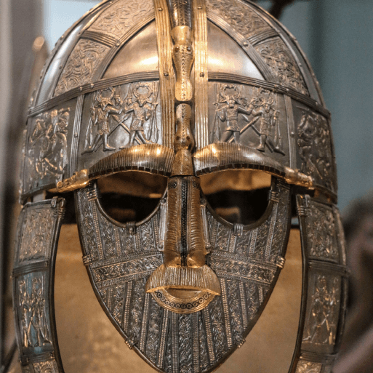
Scrumdiddlyumptious
Years 3 & 4
Autumn Term 1
Sept 2024
TOPIC OVERVIEW
As Historians, we will be investigating the years from when the Romans left Britain up to the Norman Invasion of 1066 , including the invasions of the Anglo-Saxons and the Vikings.
As Scientists, we will investigate food and the digestive system and sound. We will look at how sound is made, how it travels, pitch and volume.
As Geographers, we will create our own Invasion Map and we will learn about 4 and 6 digit grid references, natural features and manmade features found on an Ordanance Survey Map.
As Design Technologists, we will design and make a piece of material using the weaving technique of warp and weft.
ENGLISH
Anglo Saxon poetry: We will be looking at the characteristics of Anglo-Saxon poetry through the poem Beowulf and creating our own.
Playscripts: We will be looking at creating a play based on our knowledge of the Anglo-Saxons. We will be learning about the differences between playscripts and stories.
Class text: The Saga of Eric the Viking by Terry Jones
How you can help at home:
Ensure homework is completed
Discuss newly learnt words (spellings).
Encourage your child to read.
MATHEMATICS
Children will be taught key aspects of the following:
Place Value
Addition
Subtraction
Times tables
How you can help at home:
Ensure your child completes their maths homework book weekly
Practise their times tables
RE
Physical health and well-being:
we will be looking at what is
important to me? why people may
eat or avoid certain foods -religious, moral, cultural or health reasons, and any other factors.
We will also learn about the importance of getting enough sleep.
Who do Christians believe Jesus is?
We will be learning and exploring the incarnation and Jesus as son of God.
We will look at various names for Jesus and explore the concept of Messiah .
PSHE
E-SAFETY & COMPUTING
Music:
We will develop our singing technique with the theme of Vikings. We will learn to keep in time and work on musical notation and rhythm.
The Internet:
We will learn that the World Wide Web is part of the internet, and be given opportunities to explore it. We will learn about sharing information and photos on the internet.
MUSIC
Design and make clay
Anglo Saxon brooches
Watercolour backgrounds and add castle designs in the foreground
Sketches of Norse gods and Viking long ships
Learn about great artists, architects and designers in history
Create sketchbooks to record their observations and use them to review and revisit ideas
ART
SMSC
PE
Describing Portraits:
We will learn description
words for boy and girl, hair colour, eye colour and understand that the adjective goes after the noun in French.
Events in school to support our SMSC development will include; RE day, Pupil Voice, Black History Month.
Hockey & athletics:
We will learn the rules and begin to play hockey as a team game. In athletics, we will be preparing for our Sports Day.
FRENCH
SMSC

