Slide 1
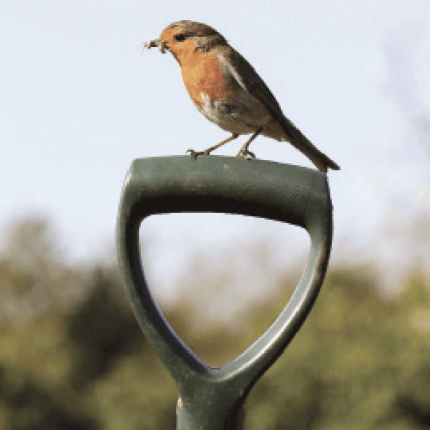
Griffin Topics
Summer Term 2
June 2024
TOPICS OVERVIEW
As Scientists, we will learn about electrical circuits, their components and how they function. We will design and make a programmable device. We will also look at how light behaves and explore how we see light and colours, and phenomena associated with light, including shadows, reflections and refraction.
As Geographers, we will learn about our changing world and revise the features of Earth. We will develop our map skills and find out more about map scales and symbols, grid references and contour lines. We will analyse data and carry out fieldwork. We will learn about climate change and the importance of global trade.
As Design Technologists, we will learn about remarkable engineers and significant bridges. We will discover how to identify features such as beams, arches and trusses. Finally, we will complete a bridge-building challenge to create a bridge prototype.
ENGLISH
Non-chronological reports: we will write reports about allotments and plan and design our own allotments
Narrative: we will short stories to share within the school
Recounts: we will write recounts about our experiences during the residential
Drama: we will take part in the end of year production
Class text: The Secret Garden by Frances Hodgson Burnett
SPAG – apostrophes, sentence types, determiners, prepositions, adverbs, tenses
How you can help at home:
Ensure homework is completed
Discuss newly learnt words (spellings)
Encourage your child to read
MATHEMATICS
Children will be taught key aspects of the following:
Measuring
Volume
Converting units
Measurement
Decimals
Problem Solving
How you can help at home:
Ensure homework is completed
RE
PSHE
What does it mean to live a good life?
We will explore the philosophical background to making choices about how to live. This will include Aristotle’s Golden Mean and the Golden Rule.
SRE
We will learn about the changes during puberty, healthy relationships and human reproduction.
E-SAFETY & COMPUTING
MUSIC
In E-safety we will explore the importance of on-line safety including privacy and security.
In Computing, we will find out that vector images are made up of shapes and will learn how to use the different drawing tools and how images are created in layers.
School Production
We will develop our singing and musical skills whilst taking part in the end of year school production.
SMSC
ART & DESIGN
PE
FRENCH
We will learn about Environmental Artists and how they address concerns relating to the natural and urban environment. We will create artwork using the principles of reuse, recycle and repurpose.
We will develop our ball skills through playing tennis. We will take part in athletics and swimming. We will participate in other activities during the residential.
We will learn to speak with increasing confidence, fluency and spontaneity. Topics for this term include: La France, au vacances et les vetements.
We will explore spiritual, moral, cultural and social issues. We will do this through a range of events and activities including the Leavers’ Service, RE Day and Pupil Voice,

