Slide 1
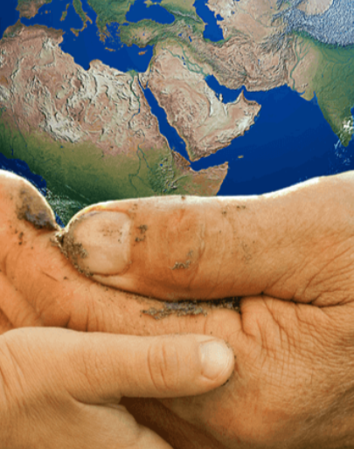
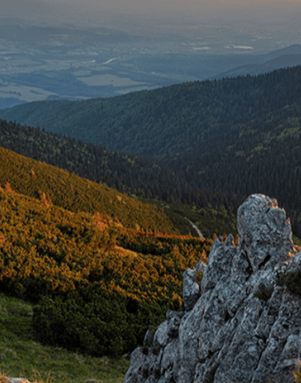
Big Wide World
Pegasus Class
Summer Term June 2024
Characteristics of Learning
As Investigative Learners we will explore and experience things, and ‘have a go’.
As Active Learners we will concentrate and keep on trying if we encounter difficulties and enjoy our achievements.
As Creative and Critical Thinkers we will formulate our own ideas and make links between ideas. We will develop our own strategies for doing things.
LITERACY
MATHEMATICS
Personal, Social and Emotional Development
Communication and Language
Reading-
Nursery children will continue to develop their phonics knowledge through different animals.
Reception children will revisit all Phase 3 diagraphs and trigraphs, then begin to explore CVCC, CCVC words.
We will listen to a range of stories including; All Are Welcome by Alexandra Penfold, Clean Up! by Dapo Adeola and Don’t Spill the Milk! by Christopher Corr and Stephen Davies. We will also explore non-fiction books about the world.
Writing-
Mark making opportunities will be available inside and out. We will use our phonics knowledge to sound out words to write poetry, signs and stories.
At home you could….
- share non-fiction books about the world.
- make marks using pencils, paint, chalk, water.
-Nursery: practise name writing using correct letter formation. Practise writing other letters at the beginning of words.
- Reception: write sentences using phonics knowledge.
We will be using White Rose Mastery Guidance through the topics: Grouping and Sharing and Visualise, Build and Map
Number
We will be:
-grouping: dividing a set equally between a certain number of groups
-sharing: dividing a set by placing a certain number of items in each group
-thinking about odd and even sharing
-thinking about the concept of unequal
-consolidating our work on doubles
Shape, Space and Measure
We will:
-make and explore patterns
-describe positions
-explore mapping
At home you could….
-share objects out at home and see if it is fair
-identify whether groups are equal
-look for patterns and shapes
-think about where things are
-give instructions to build using positional language
This term we will learning about how to stay safe when crossing a road. We will continue to practise taking turns when playing a variety of games.
This term we will talk about our own experiences of holidays and places we have visited.
We will learn a variety of new vocabulary related to the world and use these words in our conversations with others.
Understanding of the World
Physical Development
This term we will develop our gross motor skills through access to the outside using tricycles and the trim trail. In PE we will be practising our jumping, throwing and running.
We will continue to develop our fine motor skills through using a range of small tools and funky finger activities to help develop hand-eye co-ordination.
This term we will be exploring different animals from around the world and what habitats they live in.
Expressive Arts and Design
RE
SMSC
This term we will develop our art skills through using a variety of resources to create pandas, lions, geckos, monkeys as well as the Taj Mahal and the Earth.
We will use our imagination in our role play area linked to our interests.
Are all families the same?
We will explore the diversity found within, as well as between families. We will think about the idea of difference and respect for difference.
As part of our SMSC curriculum, children will participate in a variety of activities, including intra house sports competitions and RE days.

