Slide 1
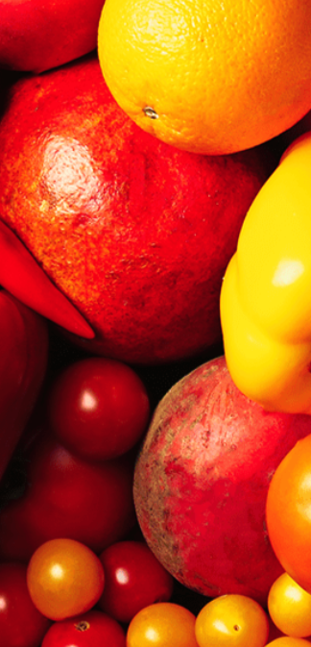
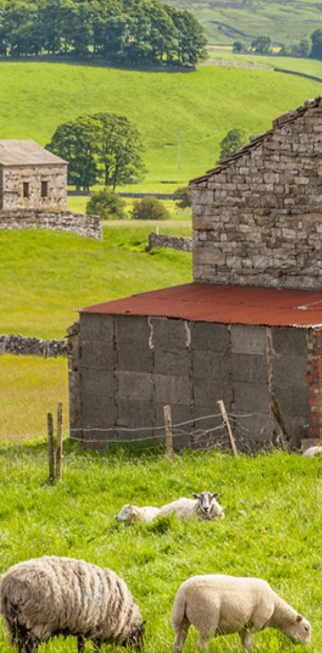
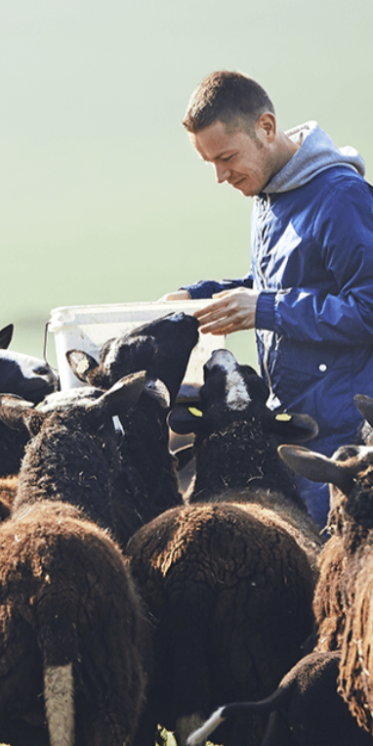
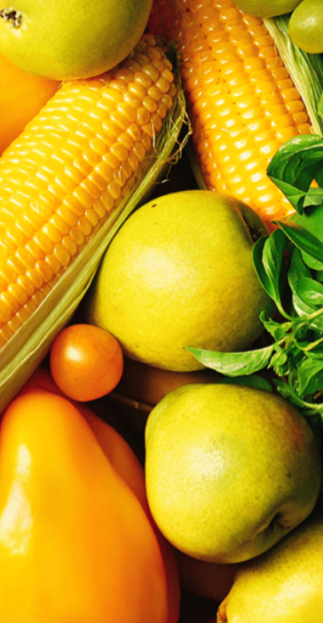
Ready Steady Grow
Pegasus Class
Spring Term February 2025
Characteristics of Learning
As investigative learners we will explore and experience things, and ‘have a go.’
As active learners we will concentrate and keep on trying if we encounter difficulties and enjoy our achievements.
As creative and critical thinkers we will generate and develop our own ideas, make links between ideas, and develop our own strategies for doing things.
.
LITERACY
MATHEMATICS
Personal, social and emotional development
Communication and Language
Reading-
Nursery children will continue to develop their phonics knowledge through the topics ‘People Who Help Us’ and ‘Animals’. Reception children will continue to develop their recognition of sounds; exploring Level 3 diagraphs and then further manipulate the sounds they have already learnt. We will listen to a range of stories with a theme of Ready Steady Grow, sing songs and share rhymes.
Writing- there will be opportunities for mark making inside and out. We will use our phonics knowledge to sound out words for poetry, stories and recounts. We will continue to practise correct letter formation when we write.
At home you could….
-share stories together
-make marks using pencils, paint, chalk or water
-try name writing using correct letter formation
- share non-fiction books about the food.
This term we will continue to use White Rose Mastery Guidance to continue to explore the topic: ‘Growing 6, 7, 8’and then move onto ‘Building 9 & 10.’
We will:
Number
-combine two amounts
-make pairs
-comparing numbers to 10
-explore number bonds to 10.
Shape, Space and Measure
-explore length and height
-measure using non-standard units
-compose and decompose shapes
-explore repeating patterns.
At home you could….
-count objects up to ten around the house
-practise writing numbers 0-10
-bake
-measure objects around your home
-make repeating patterns with items in your house.
This term we will:-
-explore different foods to decide which ones are most healthy
-carry out an experiment to show the importance of hand washing
This term we will:-
-talk about what foods we like and dislike
-listen to others
-ask questions
-hold a conversation with others
Understanding of the World
Physical Development
This term we will:-
-carry out an experiment to find out where seeds grow best
-grow our own beans
-explore different food packaging
-taste different fruit and vegetables
This term we will:-
Gross Motor- access outside for play on bikes, tricycles climbing frames and obstacle courses.
Fine Motor- use a range of small tools and funky finger activities to develop fine motor control.
Expressive Arts and Design
RE
We will develop our art skills by creating still life paintings of fruit and vegetables, use fruit and vegetables to print and explore the artist Giuseppe Arcimboldo.
We will use our imagination in our role play area linked to our interests.
We will think about the question; Does everyone believe in God?
We will discuss different worldviews about God or a divine being.
We will also think about the Easter story and what it means to Christians.
Events in school to support our SMSC development will include; weekly forest school, RE day, World Book Day, Shrove Tuesday, Lent and Mothering Sunday.
SMSC

