Slide 1
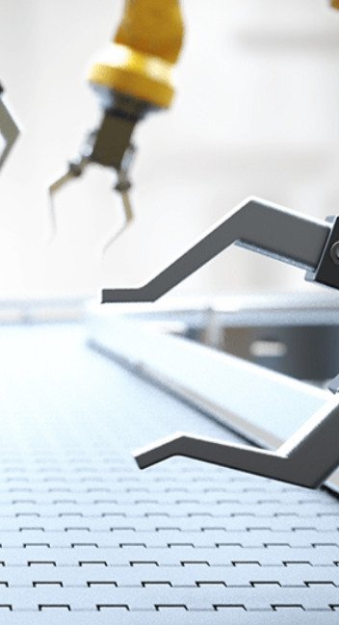
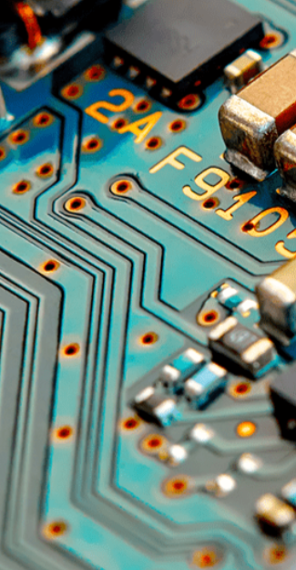
Marvellous Machines
Pegasus Class
Spring Term January 2025
Characteristics of Learning
As investigative learners we will explore and experience things, and ‘have a go.’
As active learners we will concentrate and keep on trying if we encounter difficulties, and enjoy our achievements.
As creative and critical thinkers we will have and develop our own ideas, make links between ideas, and develop our own strategies for doing things.
.
LITERACY
MATHEMATICS
Personal, social and emotional development
Communication and Language
Reading-
Nursery children will develop their phonics knowledge through the topic ‘Marvellous Machines.’
Reception children will continue to develop their recognition of sounds; exploring Level 3 diagraphs. We will listen to a range of stories with a theme of Marvellous Machines, sing songs and share rhymes.
Writing- there will be opportunities for mark making inside and out. We will use our phonics knowledge to sound out words for signs, stories and reports. We will continue to practise writing our names using the correct letter formation.
At home you could….
-share stories together
-retell favourite stories
-make marks using pencils, paint, chalk or water
-try name writing using correct letter formation
- share non-fiction books about the machines.
This term we will continue to use White Rose Mastery Guidance to explore the topic: ‘Alive in 5!’ and then move onto ‘Growing 6, 7, 8.’
We will:
Number
-explore 0 -compare numbers to 5
-explore composition of numbers 4&5
-combine two amounts
-make pairs
Shape, Space and Measure
-compare mass
-compare capacity
-explore length and height
-begin to learn about times of the day.
At home you could….
-count objects up to five around the house and practise writing these numbers
-bake
-measure objects around your home
-talk about the times of day you complete activities.
This term we will:-
-work together to solve simple goals
-grow in confidence when trying new activities
-follow rules to help keep us safe when exploring machines.
This term we will:-
-talk about machines we use
-listen to others
-ask questions.
Understanding of the World
Physical Development
This term we will:-
-explore how far cars travel down a ramp
-explore transport from the past
-learn about emergency vehicles.
This term we will:-
Gross Motor- access outside for play on bikes, tricycles climbing frames and obstacle courses.
Fine Motor- use a range of small tools and funky finger activities to develop fine motor control.
Expressive Arts and Design
RE
We will develop our art skills by sketching vehicles, printing trains and creating masks.
We will use our imagination in our role play area linked to our interests.
We will think about the question; What do people celebrate and why?
We will discuss different celebrations including Chinese and Persian New Year, Lent and Pancake Day. We will also explore Hindu festival Holi.
Events in school to support our SMSC development will include; weekly forest school, collective worship and RE Day.
SMSC

