Slide 1
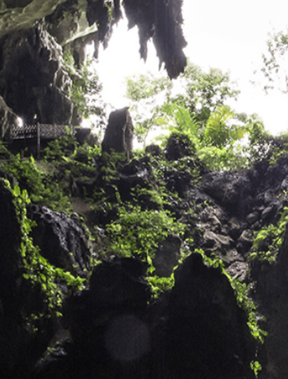
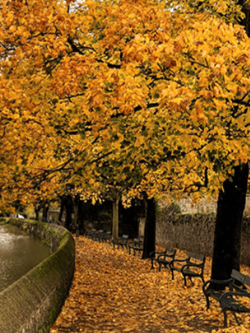
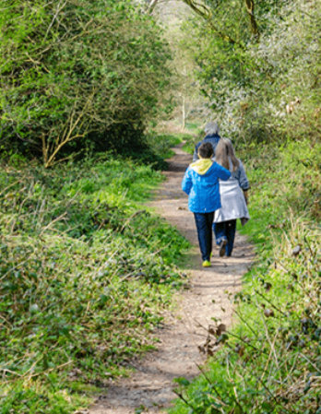
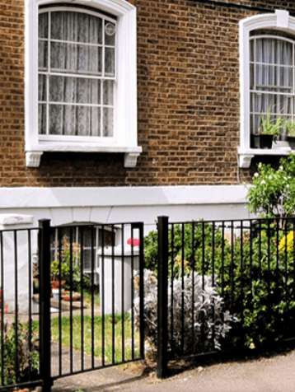
Let’s Explore
Pegasus Class
Autumn Term September 2024
Characteristics of Learning
As investigative learners we will explore and experience things, and ‘have a go.’
As active learners we will concentrate and keep on trying if we encounter difficulties, and we will enjoy our achievements.
As creative and critical thinkers we will have and develop our own ideas, make links between ideas, and develop our own strategies for doing things.
.
LITERACY
MATHEMATICS
Personal, social and emotional development
Communication and Language
Reading-
Nursery children will develop their phonics knowledge through a term’s topic called Me and My Family.
Reception children will begin to learn to read and write letters from the alphabet starting with s, a, t, p, i, n.
We will listen to a range of stories with a theme of Let’s Explore, sing songs and share rhymes.
Writing- there will be opportunities for mark making inside and out. We will use our phonics knowledge to sound out words to write lists, signs and instructions.
We will continue to practise writing our names using the correct letter formation.
At home you could….
-share stories together
-retell favourite stories
-make marks using pencils, paint, chalk or water.
-practice name writing using correct letter formation
- share non-fiction books about the world.
This term we will be using White Rose mastery guidance. We will begin the term by singing number songs, learning keys times of the day and using positional language to learn where things belong.
Then explore the topic ‘Just Like Me’ looking at:
Number
-matching and sorting
-comparing amounts
Shape, Space and Measure
-comparing size, mass and capacity
-exploring pattern
At home you could….
-sing nursery rhymes
-count objects around the house
-paint patterns using potatoes or fingers
This term we will focus on:-
-making friends, sharing and taking turns.
-learning the routines of the day.
-knowing about ourselves and our feelings.
This term we will focus on:-
-talking about ourselves and experiences.
-listening to others.
-asking questions.
Understanding of the World
Physical Development
This term we will focus on:-
-exploring the school grounds and local area.
-talking about where we have visited in the United Kingdom and further afield.
-learning about past explorers.
This term we will focus on:-
Gross Motor- accessing outside for play on bikes, tricycles climbing frames and completing obstacle courses.
Fine Motor- using a range of small tools and funky finger activities to develop fine motor control.
SMSC
Expressive Arts and Design
RE
We will develop our art skills through exploring a variety of paints, printing and collage. We will follow themes such as maps, houses and transport, as well as some inspiration from Van Gogh’s City at Night art.
We will use our imagination in our role play area linked to our interests.
We will think about the question: Who are Christians and what do they believe? We will learn about Jesus and some of his teachings and explore Christianity around the world.
We will also learn about the Harvest festival and Rosh Hashanah.
As part of our SMSC curriculum, children will participate in a variety of activities, including intra house sports competitions and RE days.

