Slide 1
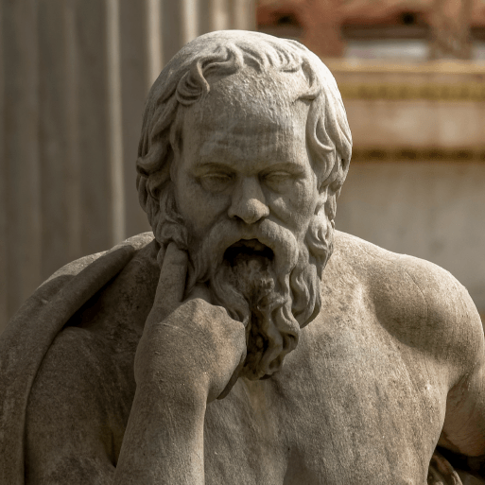
Groundbreaking Greeks
Years 5 & 6
Spring Term 2
2025
TOPIC OVERVIEW
As Historians, we will investigate the developments and changes over six periods of ancient Greek history, focusing on the city state of Athens in the Classical age, and exploring the lasting legacy of ancient Greece.
As Geographers, we will learn about locating map features using a range of methods.
As Scientists, we will investigate the wider properties of materials and their uses. We will learn about mixtures and how they can be separated using sieving, filtration and evaporation. reversible and irreversible changes and use common indicators to identify irreversible changes.
As Design Technologists, we will learn about how architectural style and technology has developed over time and then use this knowledge to design a building with specific features.
ENGLISH
Balanced arguments: we will use our knowledge of Greek debates to write a balanced argument
Playscripts: we will write a Greek comedy playscript
Odes: we will use our knowledge of Greek history to write an ode
Class text: Who Let The Gods Out by Maz Evans
SPAG – apostrophes, sentence types, determiners, prepositions, adverbs, tenses
How you can help at home:
Ensure homework is completed
Discuss newly learnt vocabulary
Encourage your child to read every day
MATHEMATICS
Children will be taught key aspects of the following:
Geometry
Algebra
Statistics
Measurement
Ratio
Four operations
How you can help at home:
Ensure homework is completed
Practise mental maths skills using One Minute Maths –
1-minute maths app | White Rose Education
RE
PSHE
What is the significance of Karma and Moksha for the Hindu?
We will explore the concepts of Samsara, Karma and Moksha, looking at the impact on the life of Hindus.
Drug, Alcohol and Tobacco Education – Weighing Up Risk
We will watch video clips and visit appropriate websites to find out how smoking, alcohol and drugs can affect the body, including the heart and relationships.
E-SAFETY & COMPUTING
MUSIC
In E-safety we will explore the importance of on-line safety including privacy and security.
In Computing we will develop our understanding of the Crumble controller, some of its associated components and the programming environment used to control it.
Film Music
In this unit we will explore and identify the characteristics of film music. We will create a composition and graphic score to perform alongside a film.
ART & DESIGN
During this term we will participate in activities that support our spiritual, moral, social and cultural education include Easter activities and Pupil Voice.
PE
FRENCH
SMSC
PE
We will develop our team and communication skills through playing ball games. We’ll also take part in dance activities and compose our own dances and sequences.
Le Temps We will learn to speak with increasing confidence, fluency and spontaneity. Topics for this term include: les temps, la boussole et le bingo.
Mixed Media
We will look at a variety of paper crafts and collage techniques and create mixed media collages.

