Slide 1
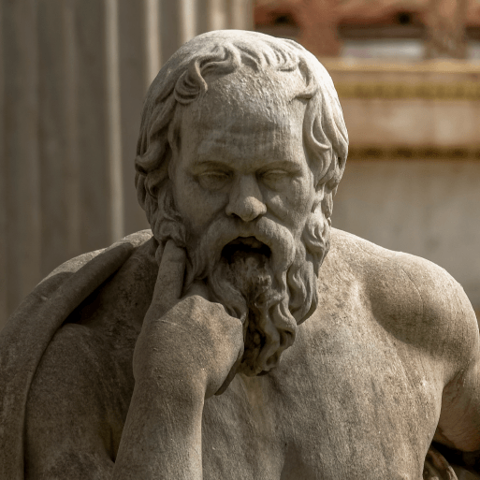
Groundbreaking Greeks
Years 5 & 6
Spring Term 1
2025
TOPIC OVERVIEW
As Historians, we will investigate the developments and changes over six periods of ancient Greek history, focusing on the city state of Athens in the Classical age, and exploring the lasting legacy of ancient Greece.
As Geographers, we will learn about the geography of ancient and modern Greece.
As Scientists, we will investigate the wider properties of materials and their uses. We will learn about mixtures and how they can be separated using sieving, filtration and evaporation. reversible and irreversible changes and use common indicators to identify irreversible changes.
As Design Technologists, we will learn about how architectural style and technology has developed over time and then use this knowledge to design a building with specific features.
ENGLISH
Myths: we will write our own Greek myths
Balanced arguments: we will use our knowledge of Greek debates to write a balanced argument
Playscripts: we will write a Greek comedy playscript
Odes: we will use our knowledge of Greek history to write an ode
Class text: The Girl of Ink & Stars by Kiran Millwood Hargrave
SPAG – punctuation, clauses, synonyms and antonyms, word classes, verb tenses
How you can help at home:
Ensure homework is completed
Discuss newly learnt vocabulary
Encourage your child to read every day
MATHEMATICS
RE
PSHE
We will be taught key aspects of the following:
Fractions, decimals and percentages
Multiplication
Division
Ratio
Algebra
Statistics
How you can help at home:
Ensure homework is completed
How do people make valid judgements about how and why the world is as it is?
We will consider the different types of questions that science and religion ask and seek to answer.
Mental Health & Wellbeing
Healthy Minds
We will learn about what mental health is. We will discuss what what can affect mental health and some ways of dealing with this.
E-SAFETY & COMPUTING
MUSIC
In E-safety we will explore the issue of safe, responsible and positive use of digital technology.
In Computing, We will learn about video production and planning, capturing, and editing video to produce a short film.
Music appreciation
During this unit we will build on previous learning, find out about different musicians and explore musical styles.
ART & DESIGN
During this term we will participate in activities that support our spiritual, moral, social and cultural education.
PE
FRENCH
SMSC
Ourselves
Children will be taught to speak with increasing confidence, fluency and spontaneity. Topics for this term include: ma famille et les vetements.
Expression
We will look at the Expressionist art movement and explore different ways to portray feelings and emotions.
PE
We will take part in gymnastics activities combining action, balance and shape. We will develop our athletics skills and abilities.

