Slide 1
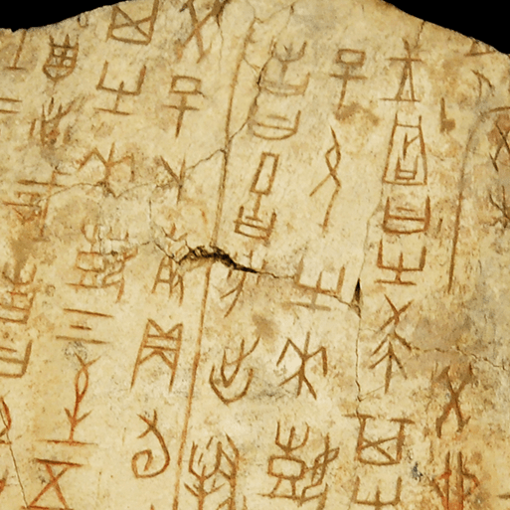
Dynamic Dynasties
Years 5 & 6
Autumn Term 1
2024
TOPIC OVERVIEW
As Historians, we will learn about the history of ancient China, focusing primarily on the Shang Dynasty, and explore the lasting legacy of the first five Chinese dynasties, some of which can still be seen in the world today. We will research the power and hierarchy of the Shang Dynasty and find out more about everyday life in ancient China.
As Geographers, we will investigate our world including looking at map features using a range of methods. We will learn about the Prime Meridian, Greenwich Mean Time (GMT), and worldwide time zones and study interconnected climate zones, vegetation belts and biomes. We will learn about human geography and capital cities worldwide before looking at the UK motorway network and settlements.
As Scientists, we will learn about mechanisms and their uses. We will also learn about the forces of gravity, air resistance, water resistance and friction.
ENGLISH
Poetry: we will write poems about ancient Chinese folktales
Biographies: we will write biographies on leaders of the Shang dynasty
Story writing: we will write a story from another culture
Class text: The Girl of Ink & Stars by Kiran Millwood Hargrave
SPAG – punctuation, clauses, word classes, verb tenses
How you can help at home:
Ensure homework is completed
Discuss newly learnt words (spellings)
Encourage your child to read every day
MATHEMATICS
We will be taught key aspects of the following:
Place Value
Addition
Subtraction
Multiplication
Division
How you can help at home:
Ensure homework is completed
RE
PSHE
How far is belief in the resurrection important to Christians today?
We will consider the centrality of the resurrection to Christian belief and what this tells Christians about Jesus.
Physical Health and Wellbeing
In the Media
We will learn about how the media can manipulate images and its effects.
E-SAFETY & COMPUTING
MUSIC
In E-safety we will explore the issue of on-line safety including talking safely on-line.
In Computing, we will explore the concept of variables in programming through games in Scratch
Music appreciation
During this unit we will build on previous learning, find out about different musicians and explore musical styles.
During this term we will participate in activities that support our spiritual, moral, social and cultural education including developing class and school rules, harvest, RE days and Black History Month.
SMSC
ART & DESIGN
PE
FRENCH
PE
We will participate in Forest School. We will develop our athletics skills and abilities.
Ma Famille
Children will be taught to speak with increasing confidence, fluency and spontaneity. Topics for this term include: ma famille, les vetements.
Colour in Landscapes
We will learn about colour theory by studying tints, shades and tones, before creating landscape paintings.

