Slide 1
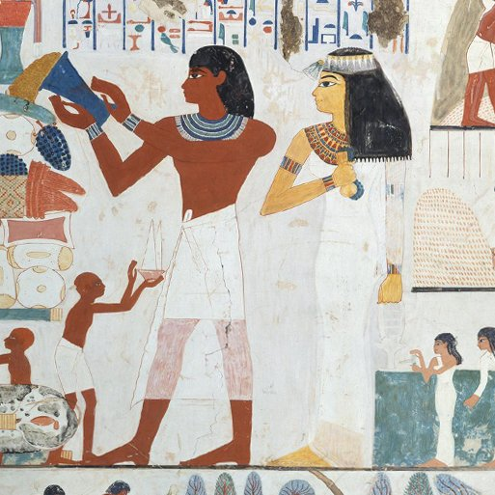
Ancient Civilisations
Years 3 & 4
Spring Term 2
March ’25
TOPIC OVERVIEW
As Historians, we will be investigating the history of three of the world’s first ancient civilisations: ancient Sumer, ancient Egypt and the Indus Valley civilisation.
As Scientists, we will investigate electricity and electric circuits. Creating circuits to turn on lights and alarms.
As Geographers, we will continue with our interconnected world looking at contrasting climates
from around the world.
As Design Technologists, we will design and make simple machines, including wheels, axles, inclined planes, pulleys and levers, exploring how they helped ancient builders to lift and move heavy loads.
ENGLISH
Stories from another culture: We will learn all the aspects of writing a story from another culture encouraging children to immerse themselves in a different way of life, by looking at setting descriptions, character descriptions and using inverted commas for speech.
Class text: Secrets of a Sun King by Emma Carroll.
How you can help at home:
Ensure homework is completed.
Discuss newly learnt words (spellings).
Encourage your child to read.
MATHEMATICS
Children will be taught key aspects of the following:
Length
Perimeter
Fractions
Decimals
How you can help at home:
Ensure your child completes their maths homework book weekly.
Practise their times tables.
How do Hindus understand God (Brahman)?
We will find out that One God is in many forms, God in everything, part of everything, different symbols for the attributes of God – and some of the stories linked to Vishnu, Shiva, Ganesha etc.
RE
Drug, alcohol and tobacco
education :
We will look at everyday drugs such as caffeine and alcohol and how we can make alternative choices. We will also look at the effects of alcohol etc on our bodies.
PSHE
E-SAFETY & COMPUTING
MUSIC
The internet
We will recognise that the internet is a network of networks including the WWW,
and why we should evaluate online
Content.
Music:
We will look at Haiku, music and performance (Theme: Hanami) This Japanese inspired topic looks at the springtime festival of Hanami, which celebrates the fleeting beauty of spring flowers..
ART
SMSC
We will explore figure drawing and make sketches of each other. Create a clay sculpture using an armature.
Replicate an Ancient Sumner sculpture using clay
Make a 3D Egyptian pyramid and decorate it with geometrical patterns.
PE
FRENCH
Events in school to support our SMSC development will include; RE day, Pupil Voice, World Book Day and Easter.
Basketball and Forest school.
We will learn the rules and begin to play basketball as a team game. In forest school, we will be enjoying our time in the woods, exploring and creating in the natural world.
Colourful creatures
We will learn the vocabulary for adjectives of size and colour, creating their own animal portraits, producing a short description.
SMSC

