Slide 1
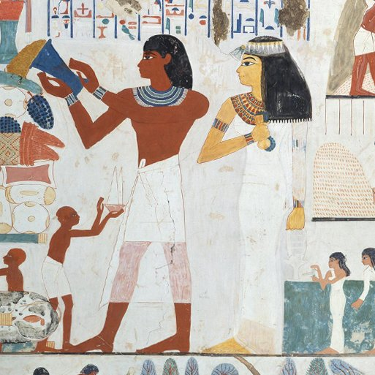
Ancient Civilisations
Years 3 & 4
Spring Term 1
Jan’ 25
TOPIC OVERVIEW
As Historians, we will be investigating the history of three of the world’s first ancient civilisations: ancient Sumer, ancient Egypt and the Indus Valley civilisation.
As Scientists, we will investigate electricity and electric circuits. Creating circuits to turn on lights and alarms
As Geographers, we will continue with our interconnected world looking at contrasting climates
from around the world.
As Design Technologists, we will design and make simple machines, including wheels, axles, inclined planes, pulleys and levers, exploring how they helped ancient builders to lift and move heavy loads.
ENGLISH
Free verse: We will be looking at creating a free verse poem inspired by one of the Sumerian Temple Hymns using expanded noun phrases
Instructions: We will be writing our set of instructions on how to make an Egyptian mummy using fronted adverbials.
Stories from another culture: We will write a story from another culture encouraging children to immerse themselves in a different way of life.
Class text: Secrets of a Sun King by Emma Carroll
How you can help at home:
Ensure homework is completed
Discuss newly learnt words (spellings).
Encourage your child to read.
MATHEMATICS
Children will be taught key aspects of the following:
Addition
Subtraction
Multiplication
Division
Area
How you can help at home:
Ensure your child completes their maths homework book weekly.
Practise their times tables.
Does prayer make a difference and
how do Christians know?
We will find out what Christians pray (e.g. Lord’s prayer) and explore what people do because they have prayed. How does prayer change things for a Christian?
RE
Mental health and emotional
wellbeing Dealing with feelings:
We will explore the different feelings we have and how we recognise those feelings in other people by facial expressions or other body language.
PSHE
E-SAFETY & COMPUTING
Sequencing sounds:
We will begin with an introduction to the programming environment, which will be new to most learners. They will be introduced to a selection of motion, sound, and event blocks which they will use to create their own programs, featuring sequences.
MUSIC
Music:
We will look at pentatonic melodies and compositions through celebrating Chinese New Year.
We will design and
colour Egyptian
Sarcophagus, sketch King Tut, sketch landscapes of the pyramids, paint sunset backgrounds and add a silhouette, design Egyptian headdresses by adding colour and patterns and create 3D pyramids from card.
ART
SMSC
PE
Calanders, birthdays and
Numbers:
We will learn numbers 1-31, days of the week, months and seasons. Hopefully, we will be having a traditional French birthday celebration in the classroom.
Events in school to support our SMSC development will include; RE day, Pupil Voice, Mental Health week activities.
Gymnastics & Invictus games
We will continue to enhance our skills through rolling, balancing, jumping, and using apparatus. In Invictus games, we will be enjoying different games that build resilience and stamina.
FRENCH
SMSC

